Slide 1
Nature-Inspired CNN Optimization
Group members:
15140094 Mohsin Ashraf
14140062 Mushood Hanif
15140107 Mehvish Hameed
14140044 Rida Yaqoob
Supervisor – Syed Qamar Askari

Slide 2
Overview
Problem Statement
CNNs
Evolutionary Algorithms
Literature Review
Description
Our Work
Benchmarks
References
Scope
Work-breakdown Structure
Learning outcomes

Slide 3
Problem Statement
Automation of CNN initialization for any given dataset with an optimal architecture for best results.

Slide 4
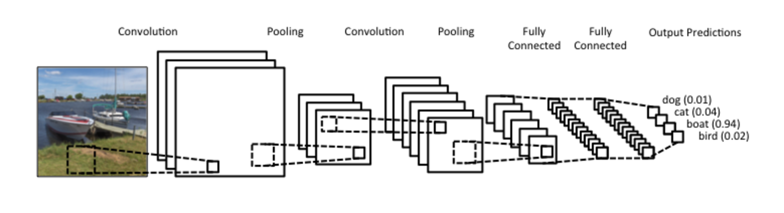
Convolutional Neural Networks
Deep Learning Network
Inspired by Humans

Slide 5
Evolutionary Algorithms
A process resulting in the improvement of a species over the span of a few generations by adapting and learning from the environment.

Slide 6
Literature Review Description
Paper | Work
ImageNet | Using CNNs on Big Data
Efficient Parallel Learning Algorithms for Neural Networks | Parallelizable techniques applied to learning in Neural Networks
Genetic Programming Approach to Designing Neural Network Architectures | Using Cartesian Genetic Programming to encode and generate optimal architectures.
Large scale evolution of convolutional neural networks using volunteer computing. | Evolving a given architecture and evolving it until optimal results arise using a genetic algorithm.
Evolving Deep Convolutional Neural Networks by Variable-length Particle Swarm Optimization for Image Classification. | Using Particle swarm optimization with an IP-inspired encoding strategy to find an optimal architecture for a given dataset.

Slide 7
Our Work
Hybrid Approach Combining All Previously Mentioned Approaches
Provided a UI for Ease of Access to Users and Better Usability
Improving efficiency by Parallelizing the CNN Evaluation Process
Compare and Contrast
Difference in the Parameters Handled
Addition of an interface for users
Parallel working efficiency

Slide 8
Benchmarks
Benchmark Datasets | Benchmarks Neural Nets
CIFAR-10 | Inception V1 (GoogleNet)
ILSVRC-2014 | AlexNet
MNIST | State-of-the-art CNN
Caltech 101 | ResNet

Slide 9
References
http://deeplearning.net/datasets/ (Benchmark Datasets)
Suganuma, M., Shirakawa, S. and Nagao, T. (2017). A genetic programming approach to designing convolutional neural network architectures. Proceedings of the Genetic and Evolutionary Computation Conference on - GECCO ‘17.
Desell, T. (2017). Large scale evolution of convolutional neural networks using volunteer computing. Proceedings of the Genetic and Evolutionary Computation Conference Companion on - GECCO ‘17.
Krizhevsky, A., Sutskever, I. and Hinton, G. (2017). ImageNet classification with deep convolutional neural networks. Communications of the ACM, 60(6), pp.84-90.
Wang, B., Sun, Y., Xue, B. and Zhang, M. (2018). Evolving Deep Convolutional Neural Networks by Variable-Length Particle Swarm Optimization for Image Classification. 2018 IEEE Congress on Evolutionary Computation (CEC).
Kramer, A. and Sangiovanni-Vincentelli, A. (2019). Efficient Parallel Learning Algorithms for Neural Networks. [online] Papers.nips.cc. Available at: http://papers.nips.cc/paper/134-efficient-parallel-learning-algorithms-for-neural-networks [Accessed 23 Apr. 2019].

Slide 10
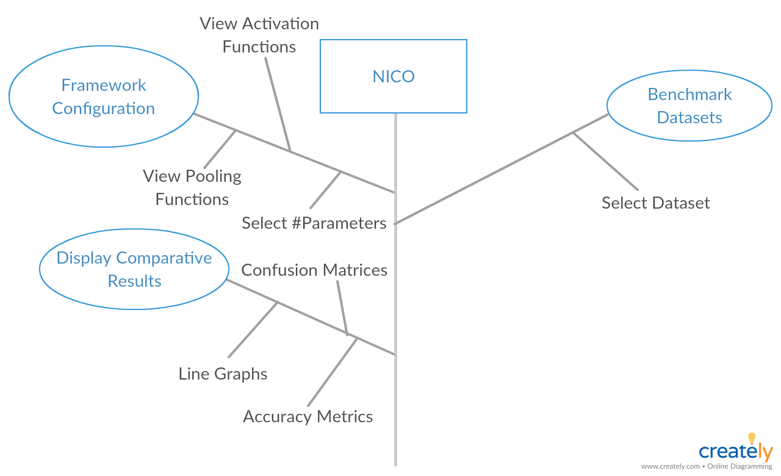

Slide 11
Learning Outcomes
Research & Development
Exposure to deep learning
Exposure to evolutionary algorithms

